Slide 1
State Space Models and Filtering
Daniel C

Slide 2
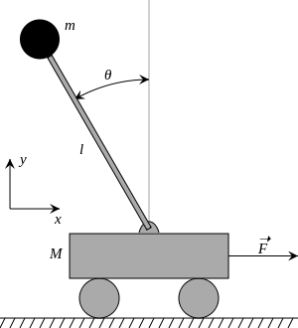
Inverted Pendulum

Slide 3
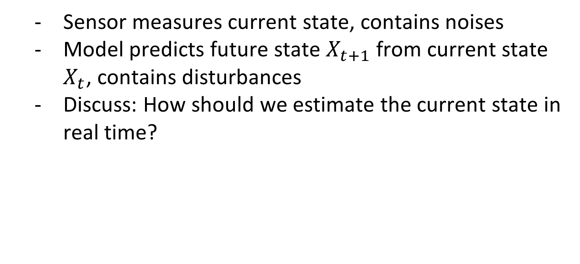
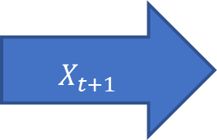
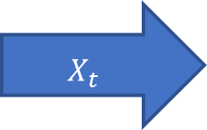
State space models
Sensor measures current state, contains noises
Model predicts future state $X_{t+1}$ from current state $X_{t}$, contains disturbances
Discuss: How should we estimate the current state in real time?
Model
Sensor
$$X_{t}$$
$$X_{t+1}$$

Slide 4
State space models
Filtering:
Estimating the current state based on all information available
Balance different sources of uncertainties
Trust measurements more if noises are smaller than model disturbances
Trust model predictions more if disturbances are smaller than noises

Slide 5
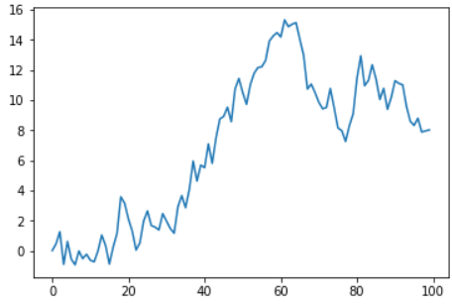
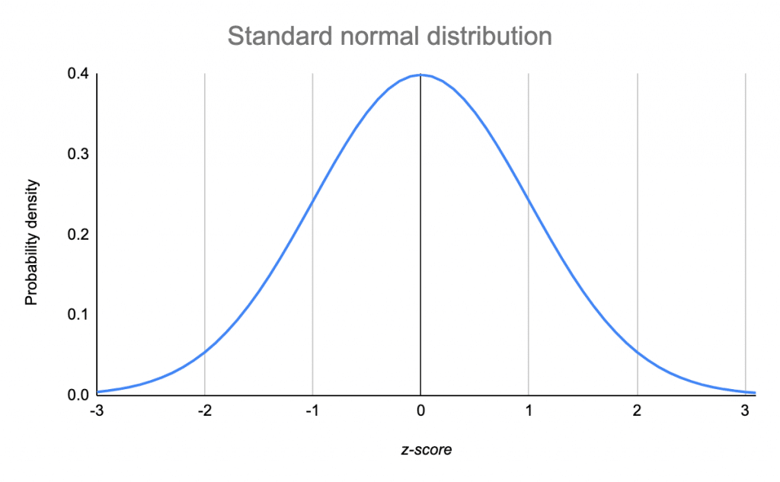
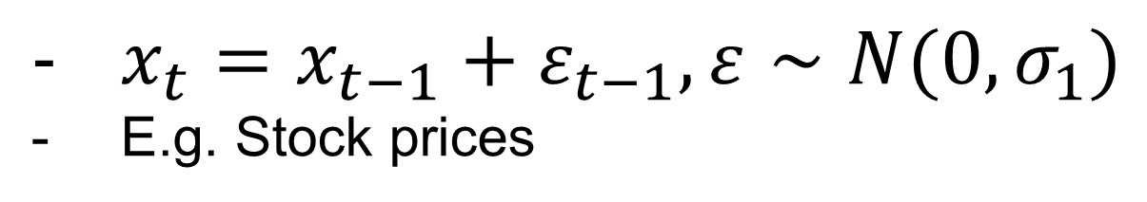
Example: Random walk
$x_{t}=x_{t−1}+ε_{t−1},ε∼N(0,σ_{1})$
E.g. Stock prices

Slide 6
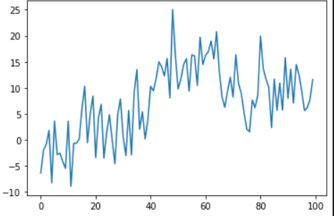
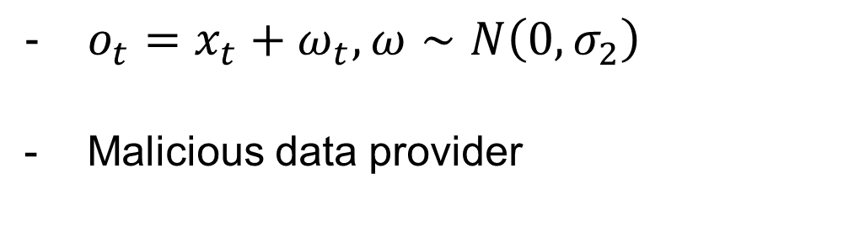
Example: Random walk
$o_{t}=x_{t}+ω_{t},ω∼N\left(0,σ_{2}\right)$
Malicious data provider

Slide 7
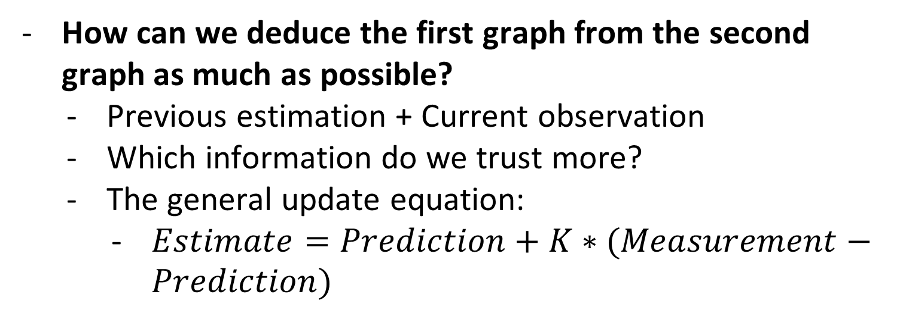
Example: Random walk
How can we deduce the first graph from the second graph as much as possible?
Previous estimation + Current observation
Which information do we trust more?
The general update equation:
$Estimate=Prediction+K∗(Measurement−Prediction)$

Slide 8

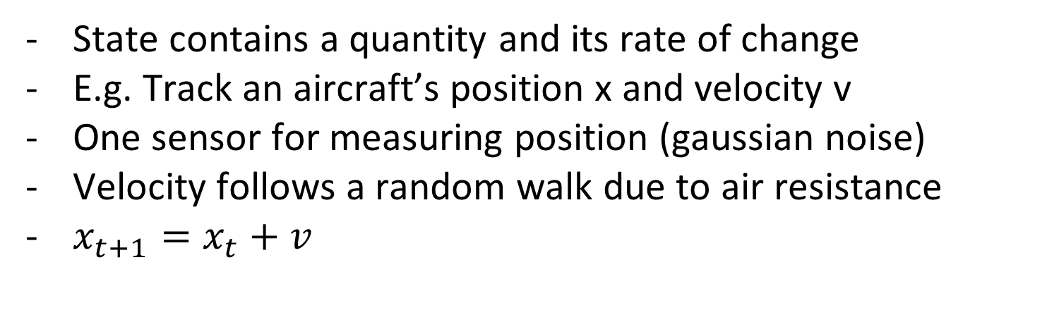
Alpha beta filter
State contains a quantity and its rate of change
E.g. Track an aircraft’s position x and velocity v
One sensor for measuring position (gaussian noise)
Velocity follows a random walk due to air resistance
$x_{t+1}=x_{t}+v$

Slide 9
Alpha beta filter
Alpha: Relative trust in measurement vs prediction of position
Beta: Relative trust in measurement vs prediction of velocity
If measured position is greater than prediction, then:
Previous estimated position is too low
Previous estimated velocity is too low
Some combination of both
Measurement greater than actual position (e.g. train)

Slide 10
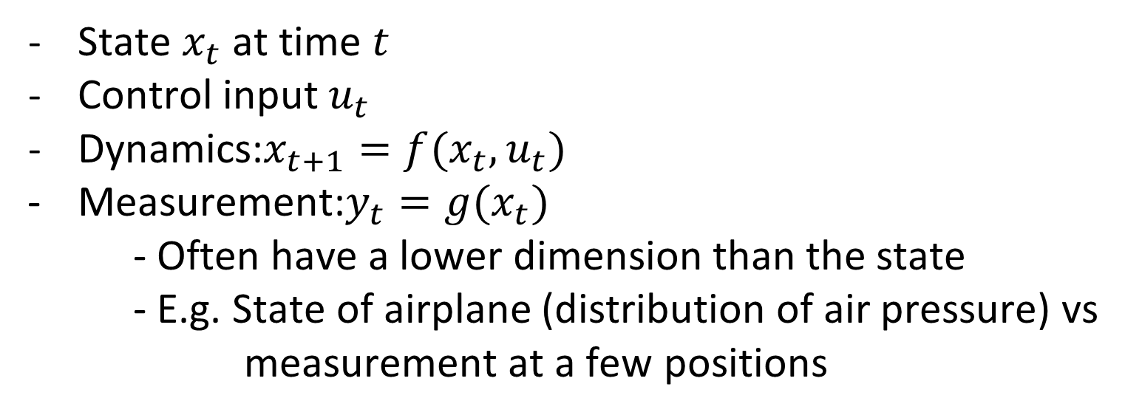
Control
State $x_{t}$ at time $t$
Control input $u_{t}$
Dynamics:$x_{t+1}=f(x_{t},u_{t})$
Measurement:$y_{t}=g(x_{t})$
- Often have a lower dimension than the state
- E.g. State of airplane (distribution of air pressure) vs
measurement at a few positions

Slide 11
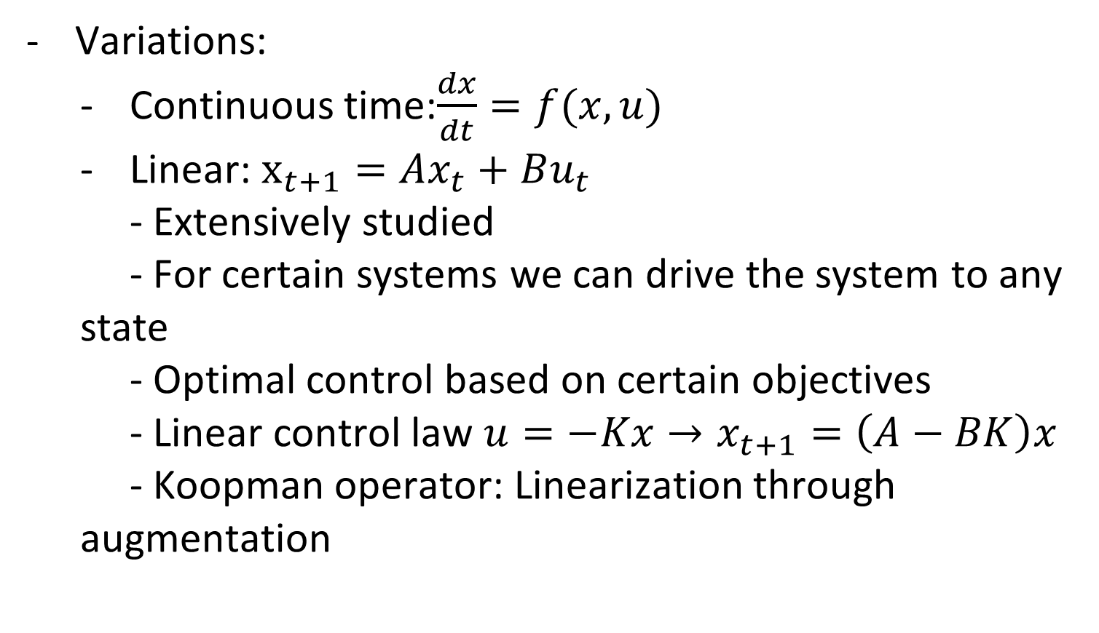
Control
Variations:
Continuous time:$\frac{dx}{dt}=f(x,u)$
Linear: $x_{t+1}=Ax_{t}+Bu_{t}$
- Extensively studied
- For certain systems we can drive the system to any state
- Optimal control based on certain objectives
- Linear control law $u=−Kx→x_{t+1}=\left(A−BK\right)x$
- Koopman operator: Linearization through augmentation

Slide 12
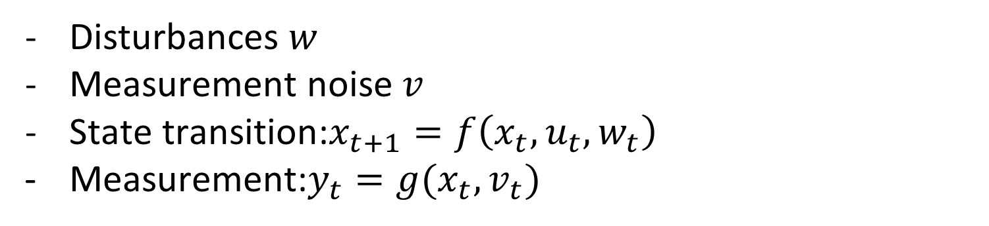
Control with uncertainty
Disturbances $w$
Measurement noise $v$
State transition:$x_{t+1}=f\left(x_{t},u_{t},w_{t}\right)$
Measurement:$y_{t}=g(x_{t},v_{t})$

Slide 13
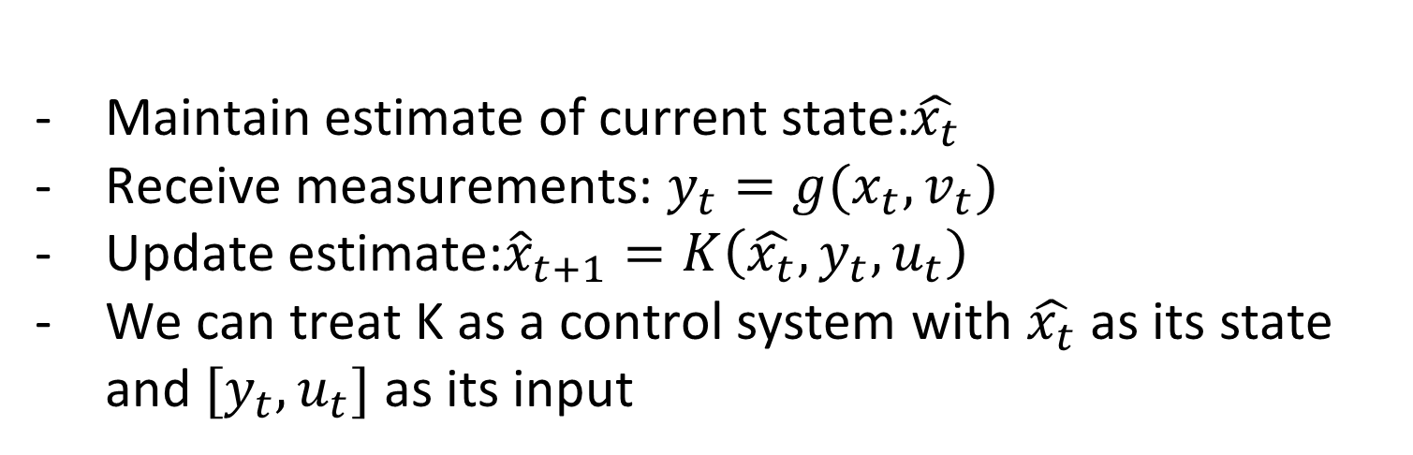
Filters for control
Maintain estimate of current state:$\hat{x_{t}}$
Receive measurements: $y_{t}=g(x_{t},v_{t})$
Update estimate:${\hat{x}}_{t+1}=K\left(\hat{x_{t}},y_{t},u_{t}\right)$
We can treat K as a control system with $\hat{x_{t}}$ as its state and $[y_{t},u_{t}]$ as its input

Slide 14
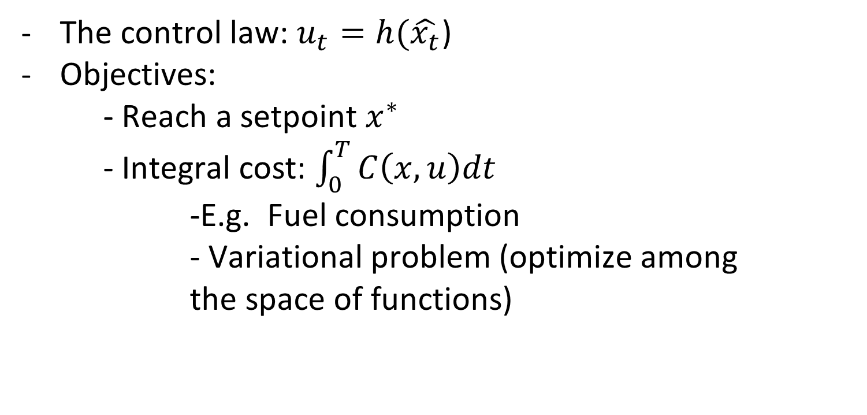
Closing the loop
The control law: $u_{t}=h(\hat{x_{t}}$)
Objectives:
- Reach a setpoint $x^{∗}$
- Integral cost: $\int_{0}^{T}{C\left(x,u\right)dt}$
-E.g. Fuel consumption
- Variational problem (optimize among the space of functions)

Slide 15
Inverted Pendulum
States:
Position
Velocity
Angle
Angular velocity

Slide 16

Inverted Pendulum
Disturbances:
Position
Velocity
$w∼N(0,0.01)$
Measurement:
noises on all variables
$v∼N(0,0.1)$

Slide 17

The kalman filter
Computes a matrix $K_{f}$ based on dynamics
Predict and update the estimate:
${\hat{x}}_{t+1}=f\left({\hat{x}}_{t},u_{t}\right)+K_{f}(y_{t}−g({\hat{x}}_{t}))$
Minimizes the expectation error:
$E\left[{\left(x−\hat{x}\right)}^{2}\right]$

Slide 18
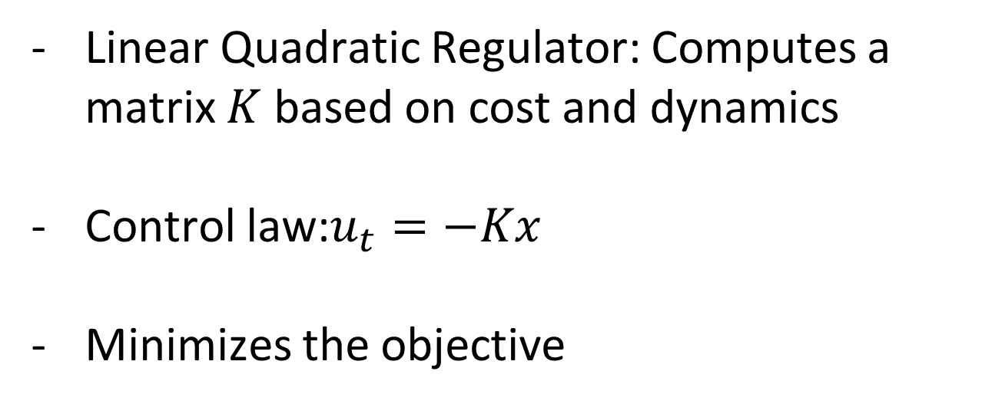
The controller
Linear Quadratic Regulator: Computes a matrix $K$ based on cost and dynamics
Control law:$u_{t}=−Kx$
Minimizes the objective

Slide 19
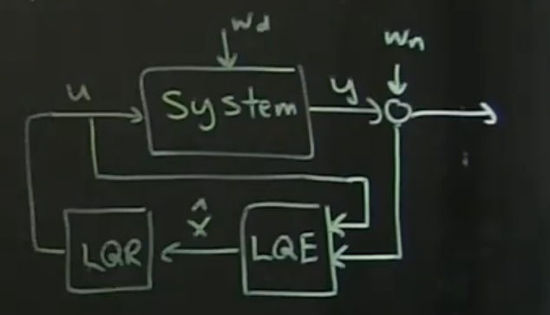
Full picture
Closed loop control with filtering

